Slide 1
CEN 414:Computer Software Engineering I
Introduction to Object Oriented, Event Driven and Procedure Oriented Programming
BY OMORUYI O.

Slide 2
Topics (Module 1)
Introduction: Comparison of procedure-oriented, event-driven, and object-oriented programming paradigms, Fundamental of object-oriented design. Features of object-oriented programming.

Slide 3
Procedure-oriented Programming
Procedural programming involves following a predetermined path that describes the task that a program should accomplish and the procedures to complete this task.
This paradigm operates by instructing the computer on what to do as well as how to go about accomplishing the specific task (Nørmark, 2011).

Slide 4
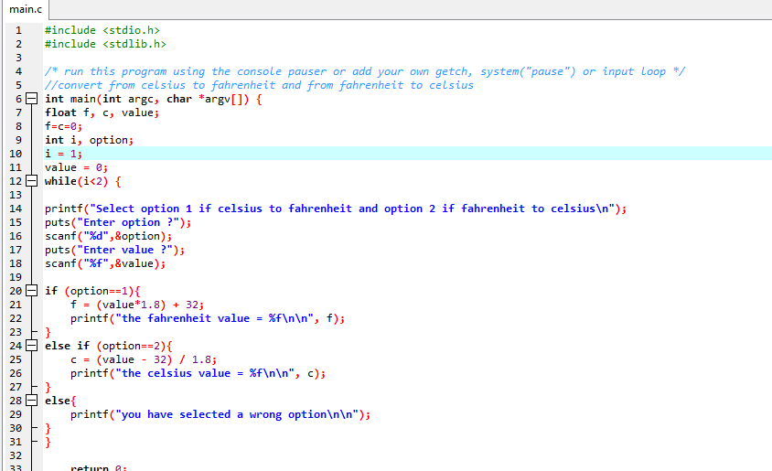
Procedure-oriented Programming Example

Slide 5
Event-Driven Programming
Event-Driven Programming is a paradigm that depends on either external or internal events in order to determine the program flow.
EDP on the other hand is a paradigm in which the program flow is partially dependent on user interaction.
External events include the click of a mouse or the hitting of a keyboard key (Nørmark, 2011).
EDP has two other distinctive features, a main loop and an event handler.

Slide 6
Event Driven programming example
Public Class RaisesEvent
Public Event SomethingHappened()
Dim WithEvents happenObj As New RaisesEvent
Public Sub ProcessHappen() Handles happenObj.SomethingHappened
' Insert code to handle somethingHappened event.
End Sub
End Class

Slide 7
Event Driven programming example
Imports System.Windows.Forms
Public Class Test
<STAThread>
Public Shared Sub Main()
Dim f As New Form()
Dim b As New Button()
b.Text = "Click me!"
AddHandler b.Click, AddressOf ClickHandler
f.Controls.Add(b)
Application.Run(f)
End Sub
Private Shared Sub ClickHandler(sender As Object, e As EventArgs)
Dim b As Button = DirectCast(sender, Button)
b.Text = "Clicked"
End Sub
End Class

Slide 8
Object-oriented programming
Object-oriented programming is a paradigm that utilizes data structures referred to as objects that interact with each other to accomplish a given task.
Four key concepts/features are important in OOP:
Objects and Classes
Encapsulation
Inheritance
Polymorphism

Slide 9
Objects and Classes
An object is a unit of information that contains procedures referred to as methods, as well as data fields referred as attributes (Schach, 2006).
Classes denote the methods and properties of an object. The data fields (attributes) hold the properties of an object, while the methods of an object are the procedures that force the object to carry out a specific function.

Slide 10
Encapsulation
Encapsulation involves packing together the data that describes the object together with the instructions that outline data manipulation (methods) (Farell, 2011).

Slide 11
Inheritance
Inheritance denotes the grouping together of classes in a hierarchical manner according to their similarity in functions.
Inheritance means that an existing object offers a foundation for other objects that share the same characteristics and behavior.

Slide 12
Polymorphism
Polymorphism is whereby different results are produced in program execution depending on the type of object that is sent to the function(Method) (Purdum, 2013).
It denotes the setting up of a line of interaction for different types of entities (objects).

Slide 13
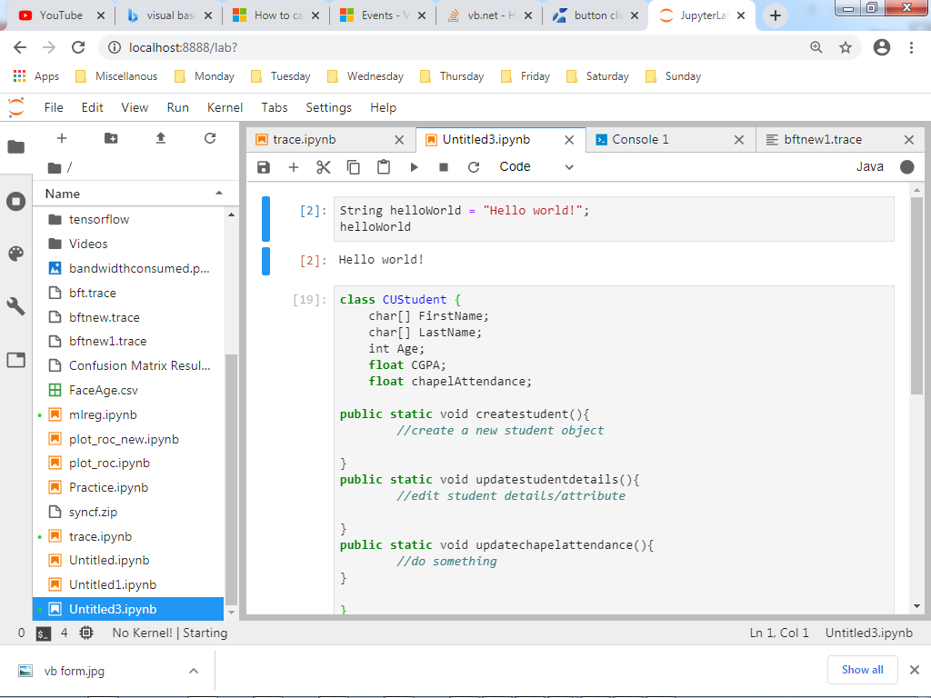
Object Oriented Programming Example

Slide 14
Differences between POP and OOP
Procedure Oriented | Object Oriented
In procedural programming, program is divided into small parts called functions. | In object oriented programming, program is divided into small parts called objects.
Procedural programming follows top down approach. | Object oriented programming follows bottom up approach.
There is no access specifier in procedural programming. | Object oriented programming have access specifiers like private, public, protected etc.
Adding new data and function is not easy. | Adding new data and function is easy.
Procedural programming does not have any proper way for hiding data so it is less secure. | Object oriented programming provides data hiding so it is more secure.
In procedural programming, overloading is not possible. | Overloading is possible in object oriented programming.
In procedural programming, function is more important than data. | In object oriented programming, data is more important than function.
Examples: C, FORTRAN, Pascal, Basic etc. | Examples: C++, Java, Python, C# etc.
.

Slide 15
Similarities and comparison of EDP and OOP
EDP shares some features with OOP that include the use of variables, procedures, classes and objects.
One feature common in EDP is the presence of a main loop within the code. The main loop constantly runs during program execution and identifies the appropriate events after which a function activates depending on the event.
The second and final feature is an event handler. An event handler is a subroutine that listens to specific events and activates a function as specified by classes and objects within the program (Schach, 2006).

Slide 16
References
Farell, J. (2011). An Object-Oriented Approach to Programming Logic and Design (4 ed.).Boston, MA: Cengage Learning.
Nørmark, K. (2011). Overview of the four main programming paradigms. Aalborg,Denmark: Aalborg University Press.
Purdum, J. (2013). Beginning Object-Oriented Programming with C#. New York, NY: JohnWiley and Sons.
Schach, S. (2006). Object-Oriented and Classical Software Engineering (7 ed.). New York,NY: McGraw-Hill Education.
https://www.geeksforgeeks.org/differences-between-procedural-and-object-oriented-programming/#:~:text=Procedural%20programming%20is%20based%20on,Java%2C%20Python%2C%20C%23%20etc.

